Slide 1
ENEL 452
Embedded and Real-Time Software Systems
Lab Section

Slide 2
Lab components
Platform
Programming Language
C/C++
Revision Control
GIT
IDE
µVision
Nucleo-64 STM32F103RB

Slide 3
Pre reqs
What you know.
Familiarity with Nucleo-64 Board or the STM32F1X series
C/C++
Keil µVision
What possibly is new?
GIT
RTOS
Real time requirements

Slide 4
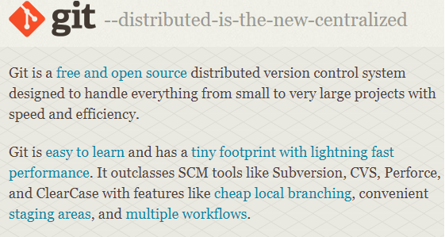
GIT
git-scm.com
Use the command line or
Graphical tool like Tortoise GIT

Slide 5
Keil µVision
µVision is a window-based software development platform that combines a modern editor with a project manager and make facility tool. It integrates all the tools needed to develop embedded applications including a C/C++ compiler, macro assembler, linker/locator, and a HEX file generator.
Full-featured source code editor.
Device Database for configuring the development tool.
Project Manager for creating and maintaining your projects.
Integrated Make Utility functionality for assembling, compiling, and linking your embedded applications.
True integrated source-level and assembler-level Debugger with high-speed CPU and peripheral Simulator.
Advanced GDI interface for software debugging on target hardware and for connecting to a Keil ULINK Debug Adapter.
Flash programming utility for downloading the application program into Flash ROM.

Slide 6
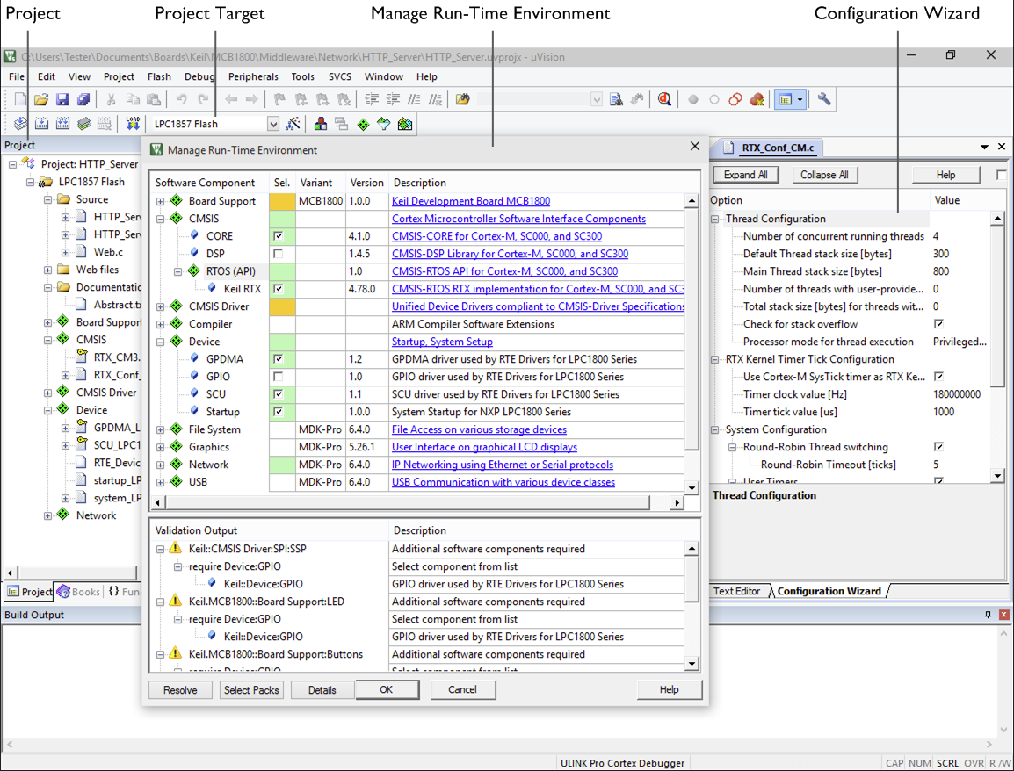
Keil µVision

Slide 7
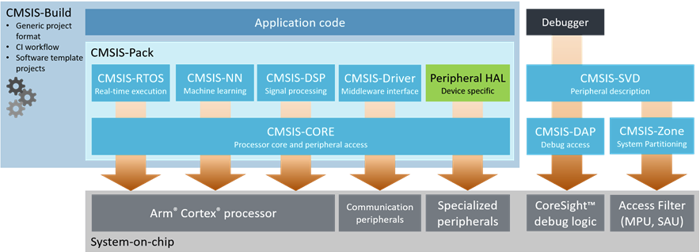
CMSIS
The CMSIS is a set of tools, APIs, frameworks, and work flows that help to simplify software re-use, reduce the learning curve for microcontroller developers, speed-up project build and debug, and thus reduce the time to market for new applications.
CMSIS reduces the learning curve, development costs, and time-to-market. Developers can write software quicker through a variety of easy-to-use, standardized software interfaces.
Consistent software interfaces improve the software portability and re-usability. Generic software libraries and interfaces provide consistent software framework.
It provides interfaces for debug connectivity, debug peripheral views, software delivery, and device support to reduce time-to-market for new microcontroller deployment.
Notes:
The Cortex Microcontroller Software Interface Standard (CMSIS) is a vendor-independent hardware abstraction layer for microcontrollers that are based on Arm® Cortex® processors. It defines generic tool interfaces and enables consistent device support. Its software interfaces simplify software re-use, reduce the learning curve for microcontroller developers, and improve time to market for new devices.
Notice that we will interface with the vendor specific (STM32) HAL. I had to google our ST family (STM32F1 HAL). This gave me the user manual for these low level drivers that we need to interface to.

